Slide 1
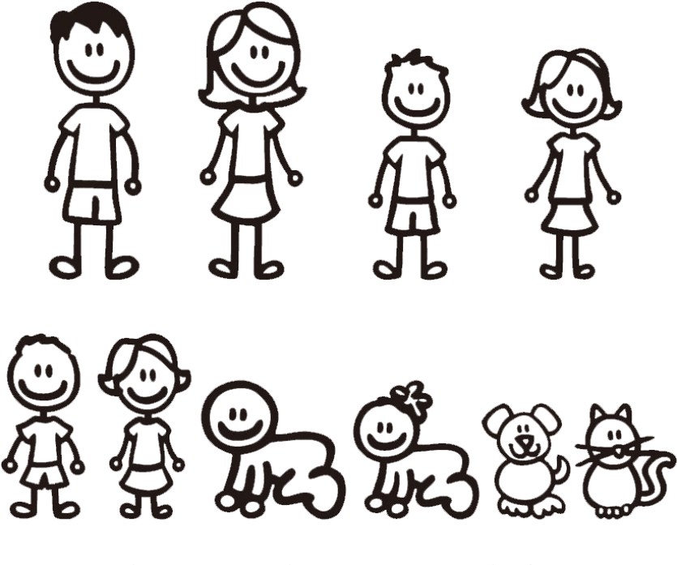
Relationships can add up quickly...
2 people
1 relationship
1

Slide 2
Relationships can add up quickly...
3 people
3 relationships
1
2
3

Slide 3
Relationships can add up quickly...
4 people
6 relationships
1
2
4
3
5
6

Slide 4
Relationships can add up quickly...
5 people
10 relationships
1
2
4
7
3
5
8
6
9
10

Slide 5
Relationships can add up quickly...
6 people
15 relationships
1
11
2
4
7
3
5
8
12
6
9
13
10
14
15

Slide 6
Relationships can add up quickly...
7 people
21 relationships
1
11
2
4
7
3
5
8
12
16
17
6
9
13
18
10
19
14
20
15
21

Slide 7
That doesn’t even count the dogs!
7 people
21 relationships
1
11
2
4
7
3
5
8
12
16
17
6
9
13
18
???????
10
19
14
20
15
21

Slide 8
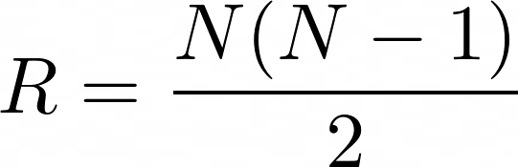
The number of relationships is exponential.

